Slide 1
Certification Exam Rapid Training AZ-104 Azure Administrator
aka.ms/az-104
aka.ms/CERT/YouTube
Mark Grimes
Principal Consultant
Microsoft Federal

Slide 2
CERT objectives
Exhibit competence In understanding how to study for and pass examS
AZ-104
Demonstrate confidence in your ability to take and pass examS
AZ-104
Have a better understanding of where best to focus your time in studying to take and pass examS
AZ-104

Slide 3

Resources
Microsoft Learn | Microsoft Docs
Browse all - Learn | Microsoft Docs
Microsoft Certified: Azure Administrator Associate - Learn | Microsoft Docs

Slide 4
Using this Deck to Study…
Some slides have multiple animations
To use this deck to study with use in “Slide Show” mode F5*
Then you will see all content AND links will work ☺
The “Click to Zoom” slide next allows you to jump to topics *
New slides from any other decks have a in the right corner

Slide 5
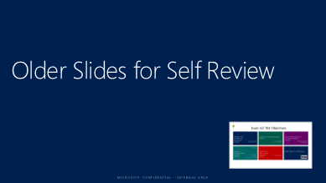
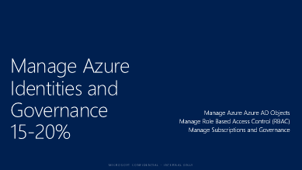
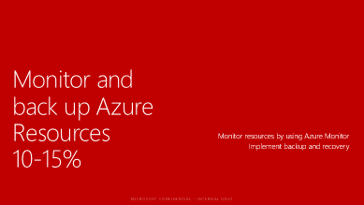
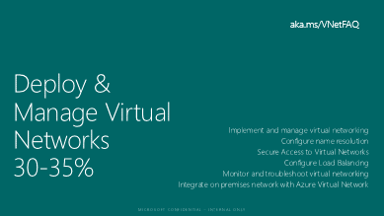
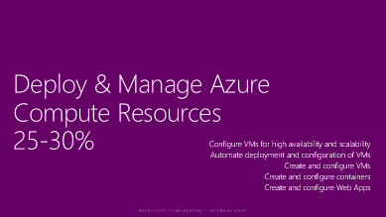
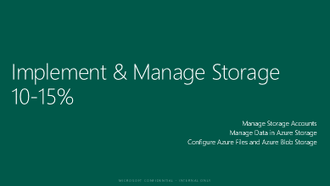
Exam AZ-104 Objectives

Slide 6
Manage Azure Identities and Governance 15-20%
Manage Azure Azure AD Objects
Manage Role Based Access Control (RBAC)
Manage Subscriptions and Governance

Slide 7
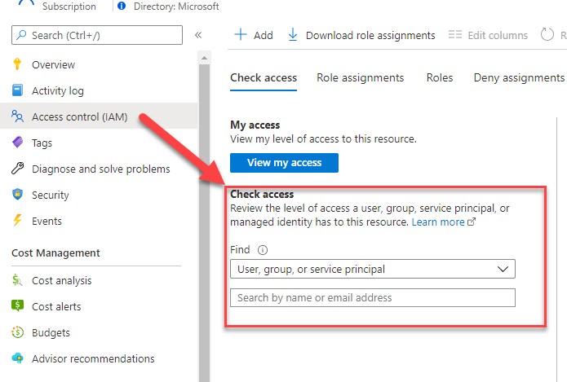
Interpret Access Assignments
Check Access feature!
Azure Role Assignments
Azure Deny Assignments

Slide 8
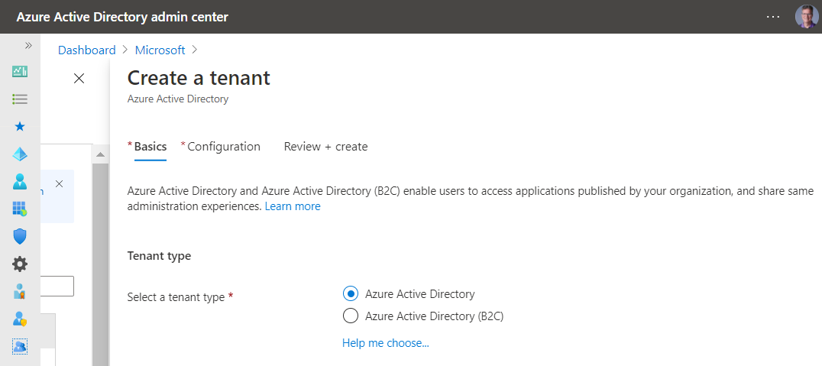
Manage Multiple Directories
Resource independence
Administrative independence
Synchronization independence
https://aad.portal.azure.com/
https://docs.microsoft.com/en-us/azure/active-directory/enterprise-users/licensing-directory-independence

Slide 9
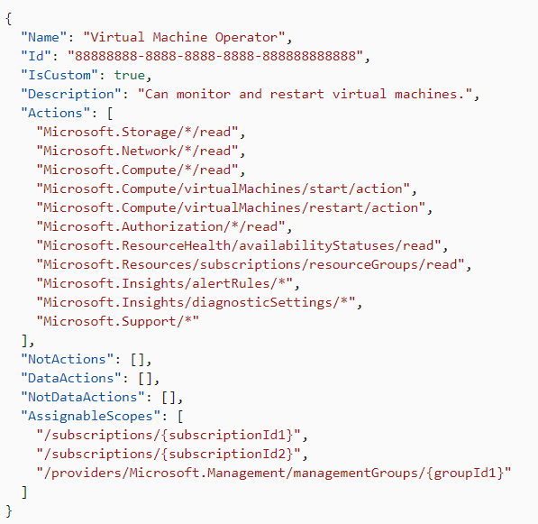
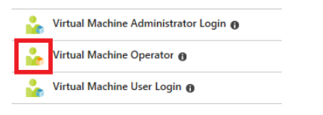
Create a Custom Role
Role Properties
Wildcard Permissions
Actions and NotActions
Steps to Create one
https://docs.microsoft.com/en-us/azure/role-based-access-control/custom-roles
https://docs.microsoft.com/en-us/azure/role-based-access-control/custom-roles-portal

Slide 10
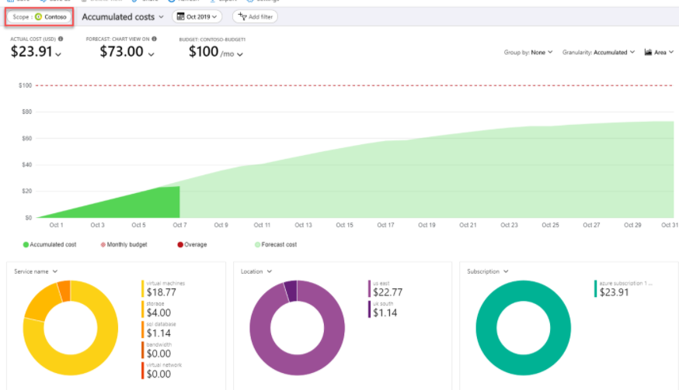

Configure Cost Management
Scopes
Group & Filter properties
Tag em
Use Cost Analysis

Slide 11
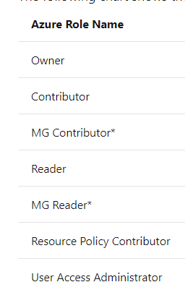
Configure Management Groups
Understand the Root Management Group
Initial Setup
Management Group Access
Custom Role definition and assignment
Move them!
Audit them!
https://docs.microsoft.com/en-us/azure/governance/management-groups/overview#initial-setup-of-management-groups

Slide 12
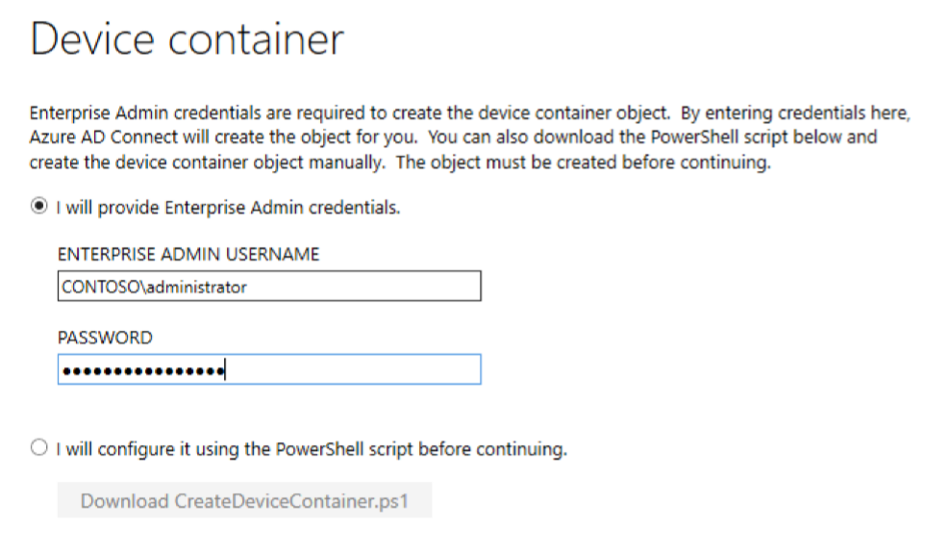
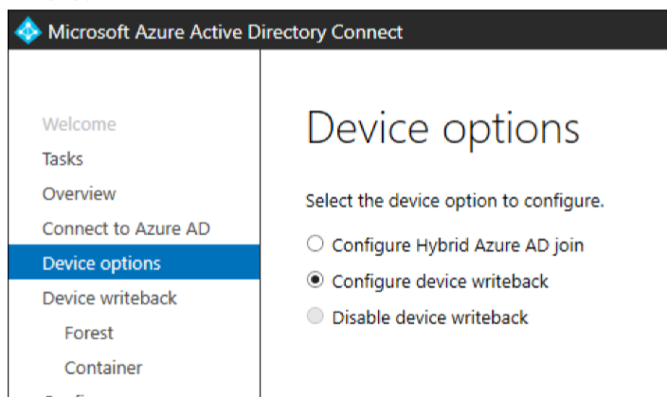
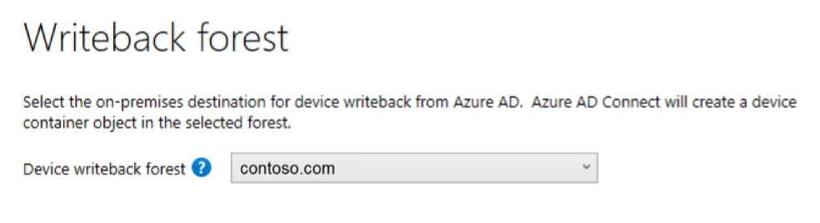
Manage password sync and writeback
Writeback Features
Additional Security to Trusted Devices
Single Forest only
FFDL 2012 R2 or higher
Azure AD Premium required
Azure AD Connect drive it
Writeback Scenarios
Windows Hello for Business using hybrid certificate trust deployment
Enable Conditional Access based on devices to ADFS (2012 R2 or higher) protected applications (relying party trusts).

Slide 13
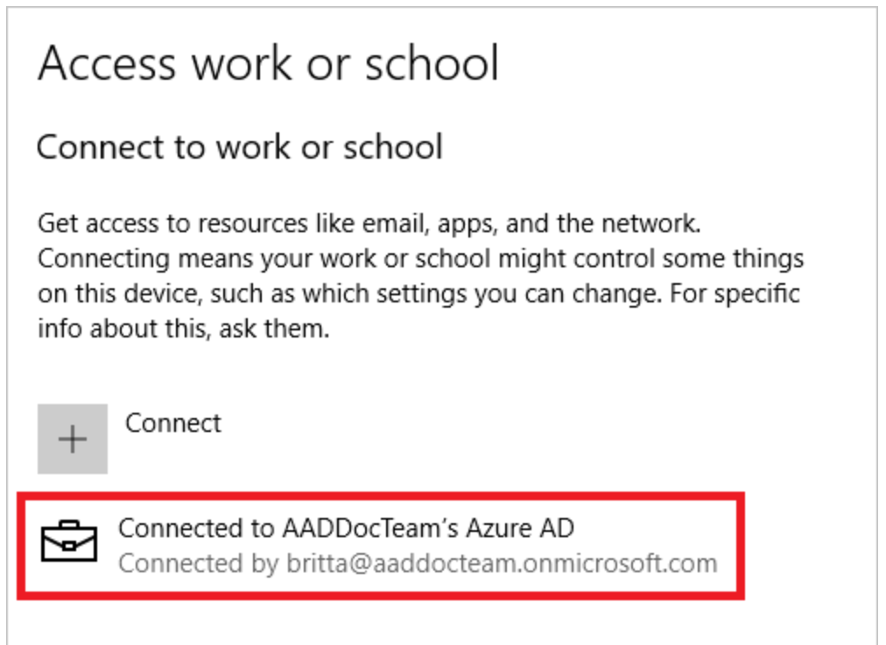
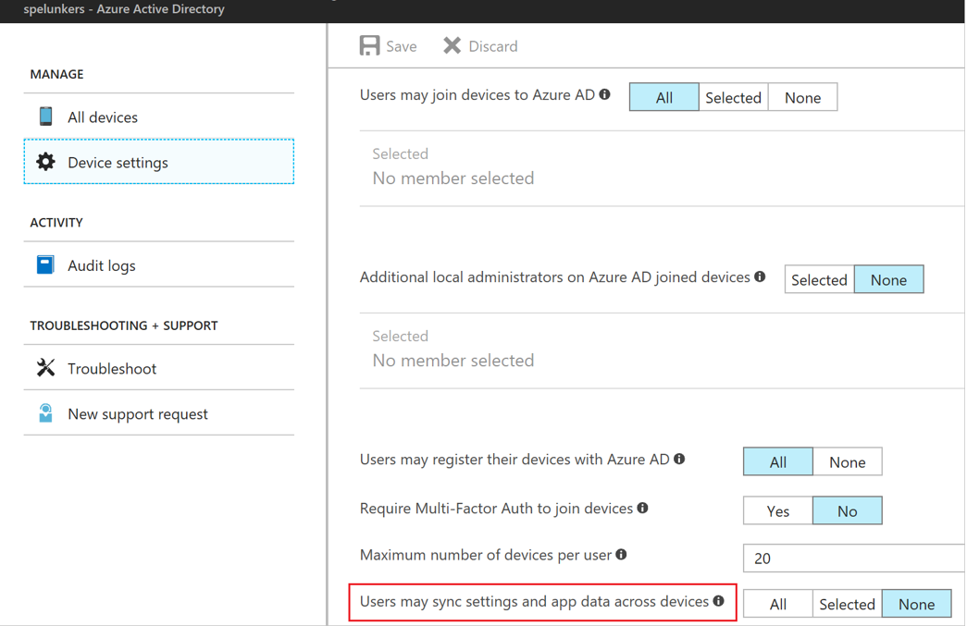
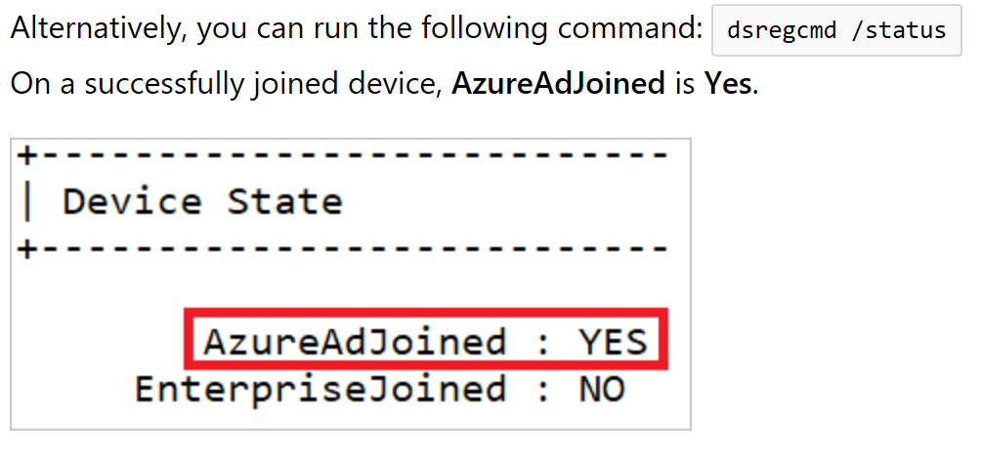
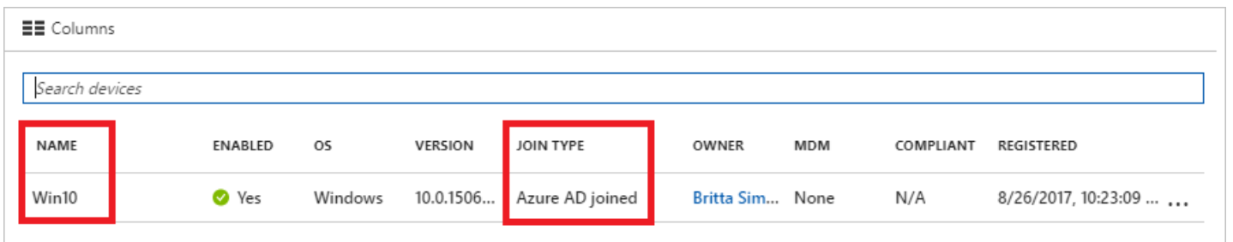
Manage Azure Active Directory (AD) Azure AD Join
aka.ms/Azure/Roaming
Requires
Azure AD + Subscription
Windows 10 (Pro/Ent)
Admin Tasks
See picture ->
User Tasks
Register Windows 10 Device – BYOD
Join Corp Device
Settings, Account, Access Work or School
Verify

Slide 14
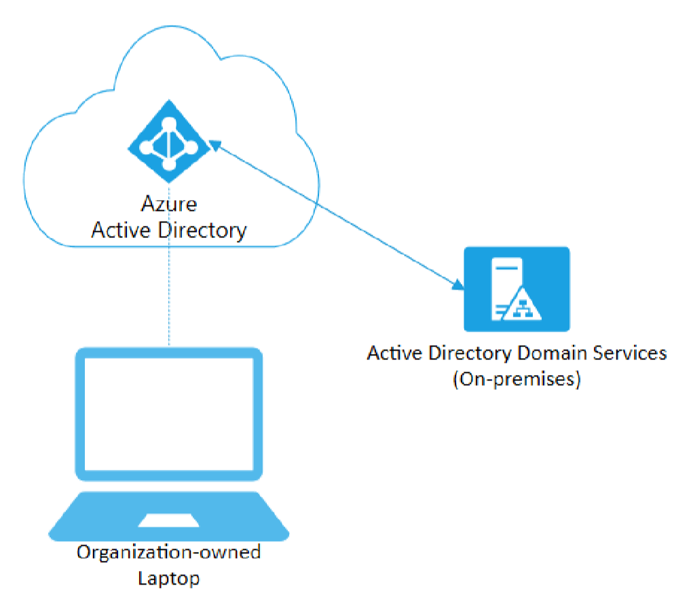
Azure AD Join
Capabilities
AuthN to Azure AD
Conditional Access Policies
Can Secure with MDM
Intune or SCCM
Can Still AuthN On-Prem
Self Service
OOBE
Bulk Enrollment
Windows Autopilot

Slide 15
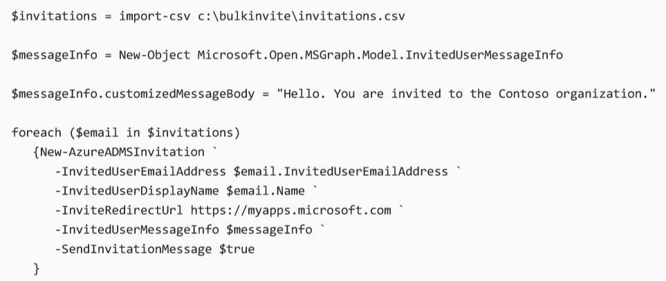
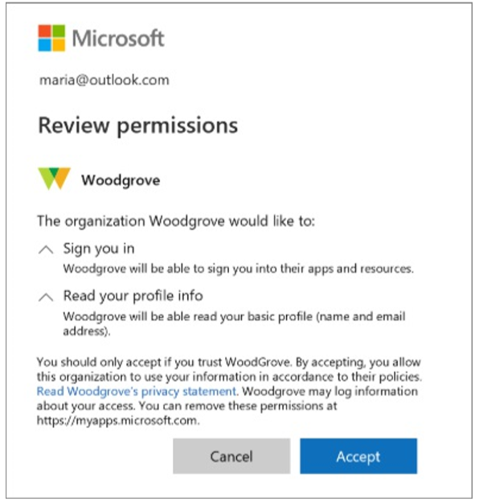
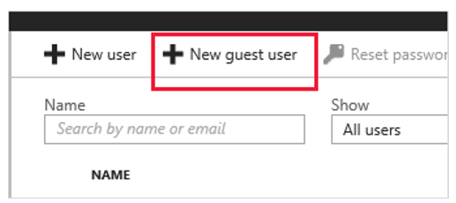
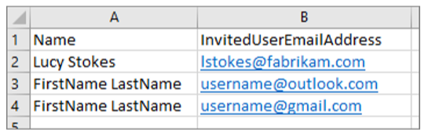
Manage Guest User Accounts
Features
Partners use their own identities
Azure AD NOT required
No management of external accounts
No need to Sync Accounts
Sign in with Work, School or social identities
Apply Conditional Access Policies
Invitation Process
Add users in the Portal
Bulk invite with CSV
Invitations.csv
Add with PowerShell
New-AzureADMSInvitation

Slide 16
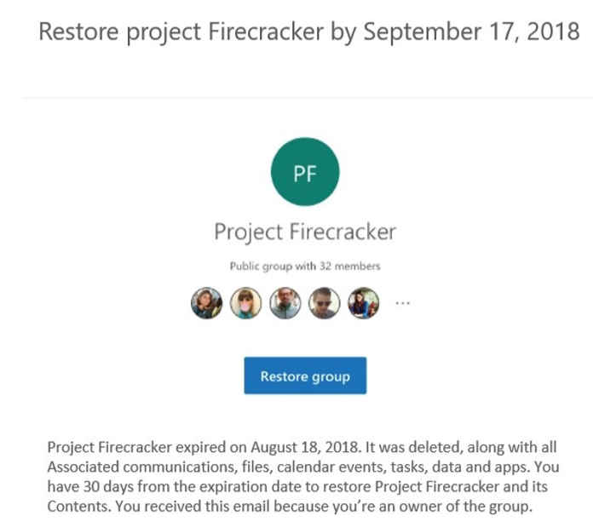
Dynamic Group Membership
Features
Add users to
Security Groups
Office 365 Groups
Change of User or Device properties
Requirements
1 Azure AD Premium license
For Global Admin
Not required to assign users
Other points
Deletion and recreate - > 24 hours
Group Expires 1 day after notification
Can be restored within 30 days

Slide 17
Subscription Governance
configure Azure policies
configure resource locks
apply tags
create and manage resource groups o move resources o remove RGs
manage subscriptions
configure Cost Management
configure management groups

Slide 18
Considerations before you Lock!

Slide 19
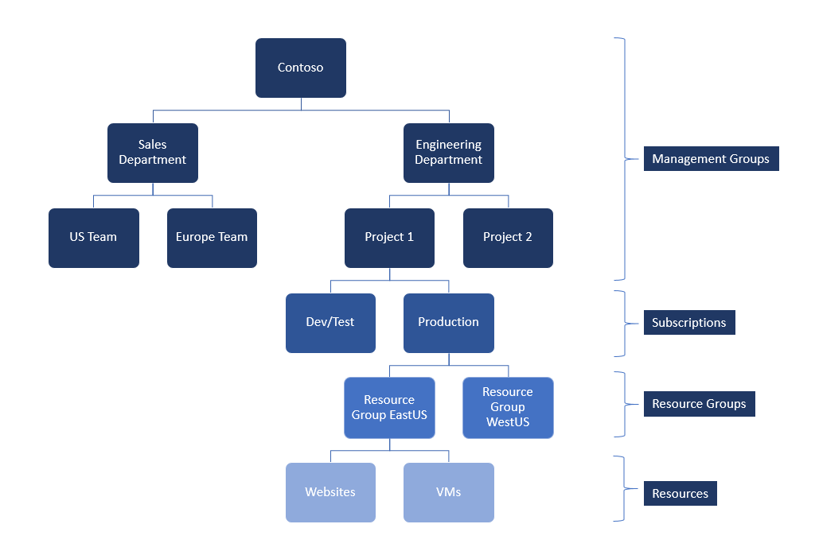
Azure Management Groups
Private Preview
Purpose
Organize Multiple Azure subscriptions
Manage
Access
Policy
Costs
Compliance
Trust with Azure AD
Trust a single Azure AD Tenant
NOTE: Policies are NOT enforced across Azure AD Directory tenants
aka.ms/Azure/MgtGroups
Check link for current status
QUESTION
Custom RBAC roles supported ?

Slide 20
Manage Resource Groups | Move Resources
Checklist:
Common Azure AD Tenant
If not the same
Transfer Ownership
Associate or add an Azure Subscription
Common Resource Providers
Quotas Exceeded?
Minimum Permissions
Microsoft.Resources/subscriptions/resourceGroups/moveResources/action on the source resource group.
Microsoft.Resources/subscriptions/resourceGroups/write on the destination resource group.
Limit of 800 moves, possible timeouts

Slide 21
Move Resources con’t
Checklist:
Does the resource support the move operation?
Some services have specific limitations
App Services move guidance
Azure DevOps Services move guidance
Classic deployment model move guidance - Classic Compute, Classic Storage, Classic Virtual Networks, and Cloud Services
Recovery Services move guidance
Virtual Machines move guidance
Virtual Networks move guidance

Slide 22
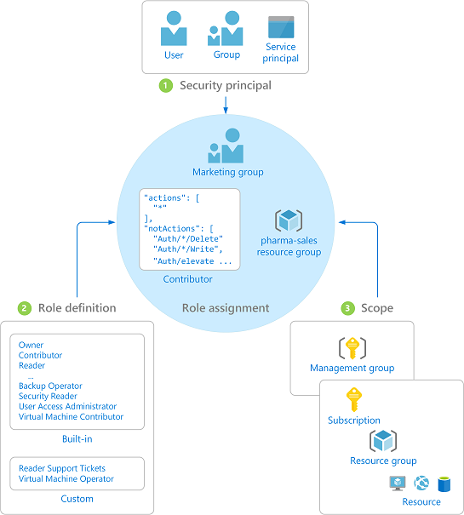
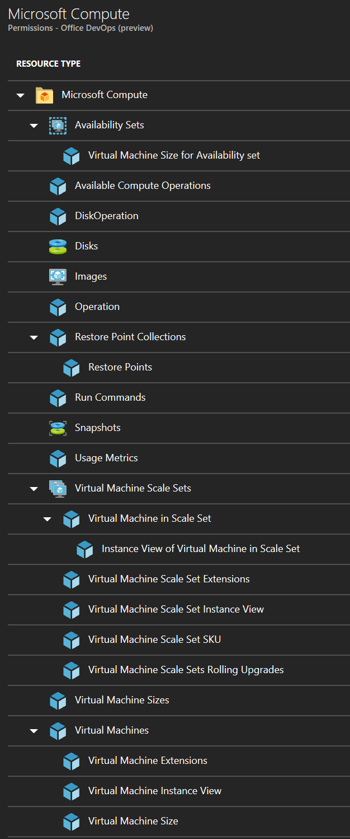
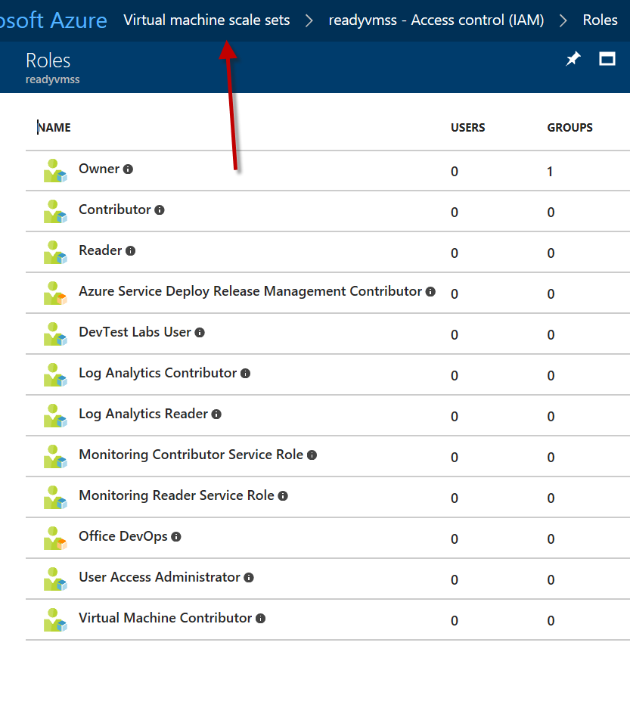
Manage Azure Subscriptions Administrator Permissions
aka.ms/Azure/Subscriptions aka.ms/Azure/RBAC

Slide 23
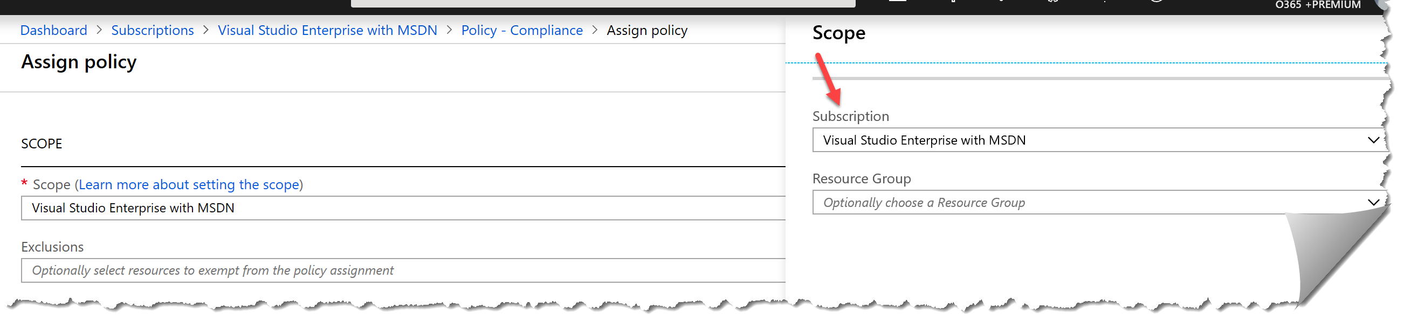
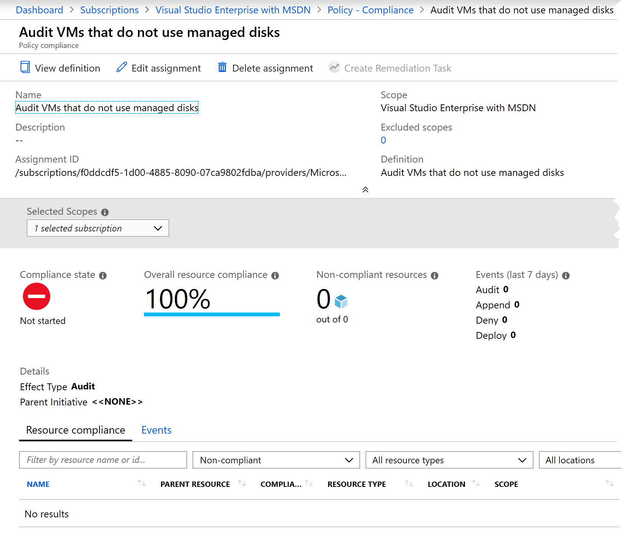
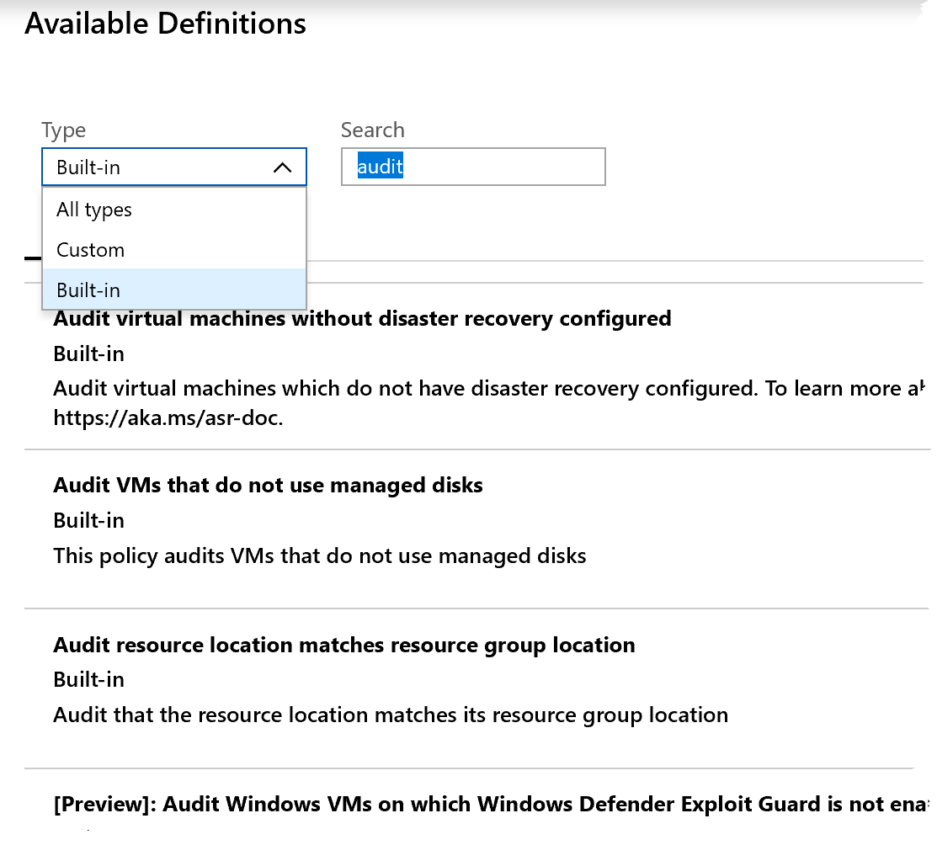
Azure Policies| At Subscription Scope
Select your Scope
Exclusions?
Resource Groups
Filter Definitions by Types /Search
All
Custom
Built-in
Managed Identities? – location
Read Azure Policies

Slide 24
Useful Azure Resource Manager Commands
az group update --name prod –rg --set tags.Dept=IT
az resource tag --tags Dept=IT Environment=Test -g examplegroup -n examplevnet --resource-type "Microsoft.Network/virtualNetworks"
az resource tag
az policy assignment
az tag add-value
az group show -n examplegroup --query tags
az resource show -n examplevnet -g examplegroup --resource-type "Microsoft.Network/virtualNetworks" --query tags
Set-AzResourceGroup -Tag @{} -Name examplegroup
Use tags to organize your resources
Manage Azure using PowerShell
Manage Azure using CLI

Slide 25
Enable MFA for an Azure Tenant
Just Read This Doc!

Slide 26
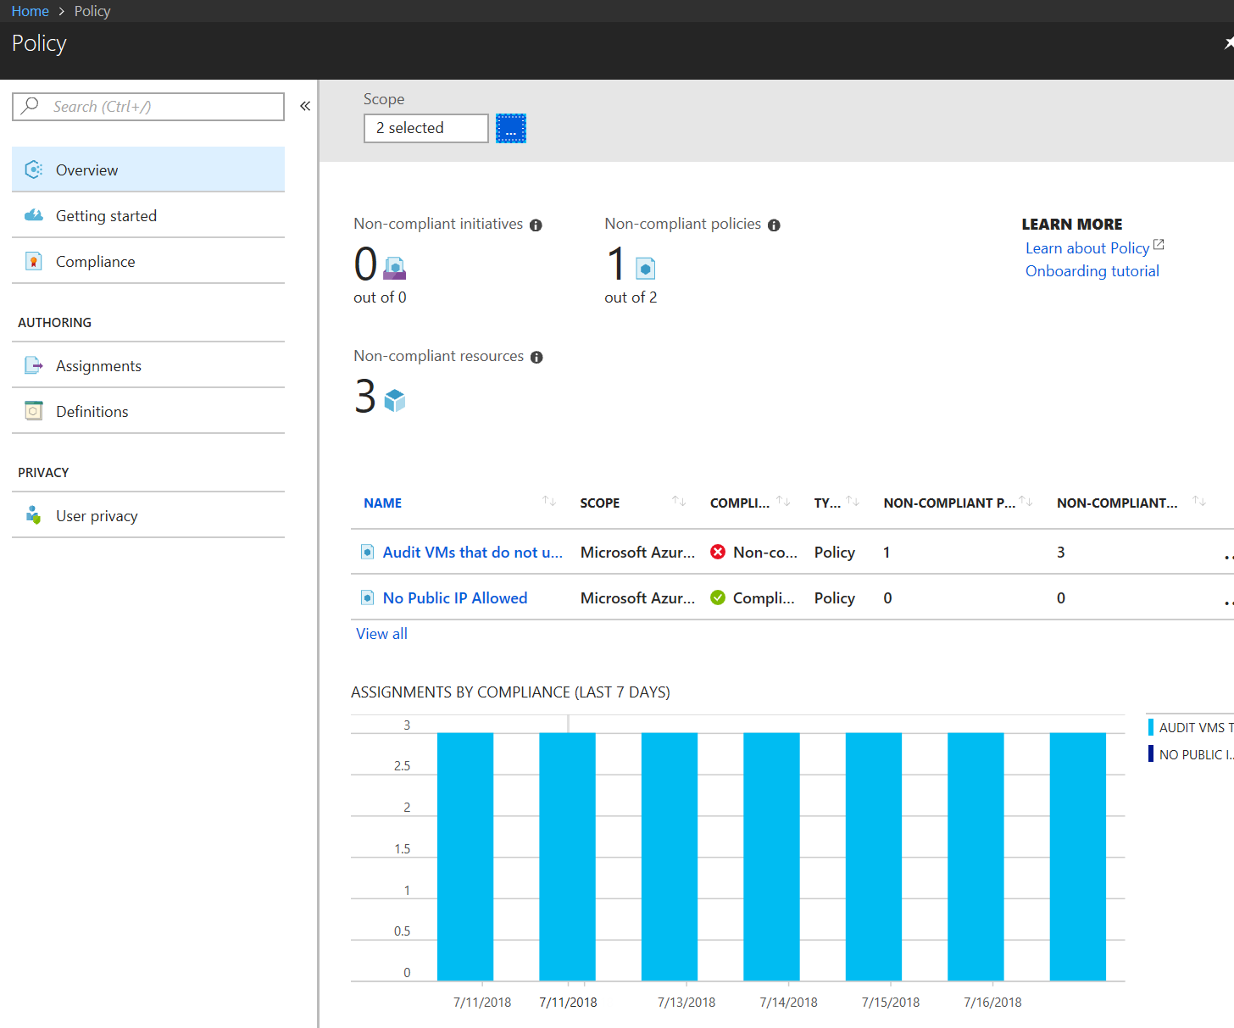
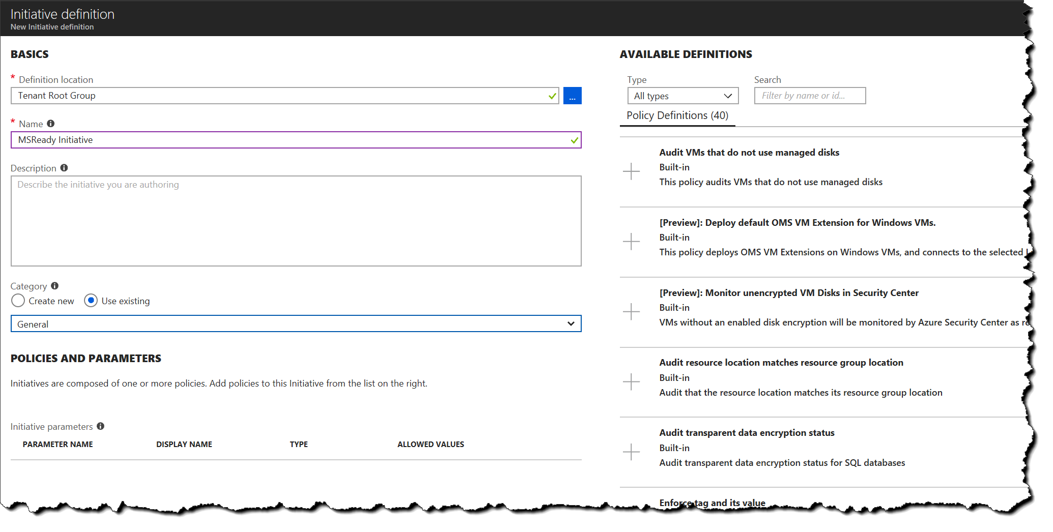
Manage Role-Based Access Control (RBAC) Implement RBAC policies
Now in the Portal!
Write Policy Definitions
Assign a Policy
Assign an Initiative
View Results, check compliance
Make exclusions by scope
Watch a Video How to
aka.ms/Azure/Policies

Slide 27
Understand Policy Effects –quiz!
Place the effects in the proper order of evaluation
Deny
Append
Audit
Disabled
For review MUST be in full screen for animation to reveal the answer ;)
Understand Azure Policy effects

Slide 28
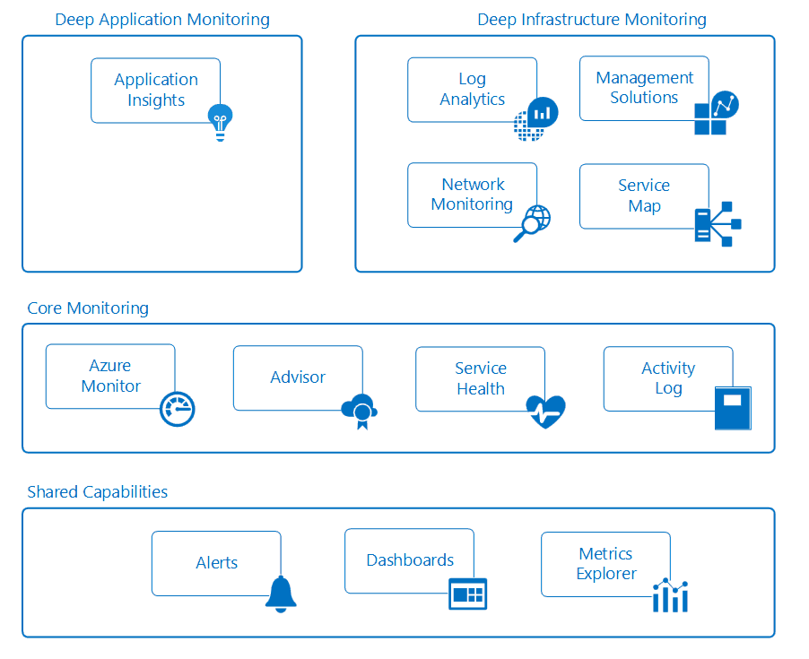
Analyze Resource Utilization and Consumption
https://docs.microsoft.com/en-us/azure/monitoring-and-diagnostics/monitoring-overview

Slide 30
Implement & Manage Storage 10-15%
Manage Storage Accounts
Manage Data in Azure Storage
Configure Azure Files and Azure Blob Storage

Slide 31
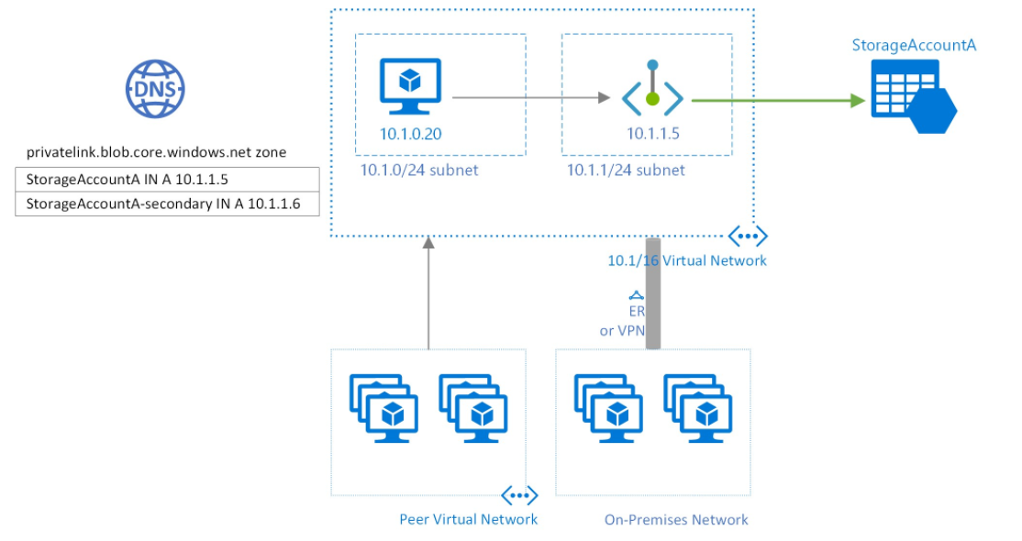
Configure Network Access to Storage Accounts
Require secure transfer
Use Private Endpoints
Configure firewalls and virtual networks
Manage TLS

Slide 32
Configure Azure AD Authentication for a storage account
Managed Identity
Authenticate a Service Principal
From a client Application
az ad sp create-for-rbac \
--name <service-principal> \
--role "Storage Blob Data Reader" \
--scopes /subscriptions/<subscription>/resourceGroups/<resource-group>/providers/Microsoft.Storage/storageAccounts/<storage-account>

Slide 33
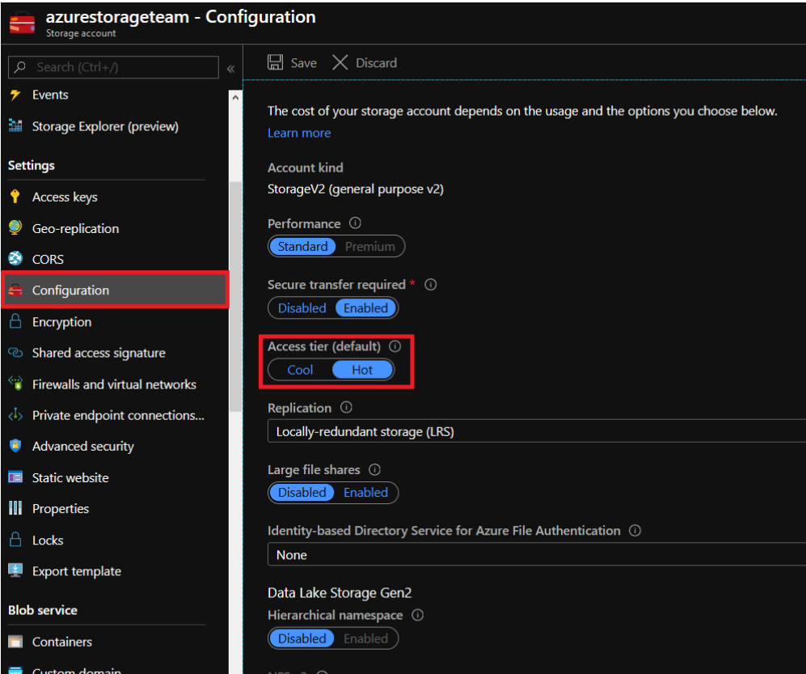
Configure Storage Tiers for Azure blobs
Available Access Tiers
Considerations
Support
Automate access tiers lifecycle
https://docs.microsoft.com/en-us/azure/storage/blobs/storage-blob-storage-tiers

Slide 34
Create Azure File Sync Service
Need Azure File Share - prereq
Prepare Windows Server
Deploy the Storage Sync Service
Install the Azure File Sync Agent
Register Server with Service
Create an Azure Sync Group - read
Create Server Endpoint
Deploy Azure File Sync

Slide 35
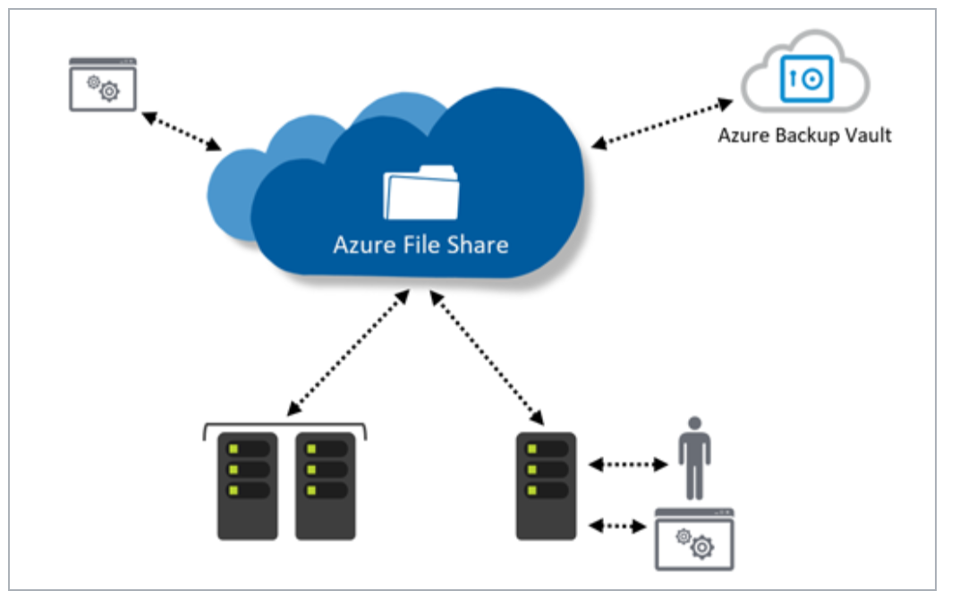
Configure Azure Files | Azure File Sync
Azure File Sync Service
Supported on
Windows Server 2012R2/16
NTFS Volumes/Compression
DFS with 1.2 Agent
Bitlocker, AIP, AAD RMS,
NOT supported
Other file systems period
Sysprep
NTFS EFS
No Other HSM
Azure Sync Group
Defines Sync Topology for set of files
aka.ms/azure/files Deploy Azure File Sync

Slide 36
Data Transfer Services
Choose Solution
Shippable Devices
Data Box Disk | 100GB -50TB
Data Box | 50-500TB
Data Box Heavy | 500TB+
Network Transfer
Storage Explorer
Scripted e.g. AZCOPY
Azure DataFactory - pipeline
Read Selecting a Data Transfer Solution

Slide 37
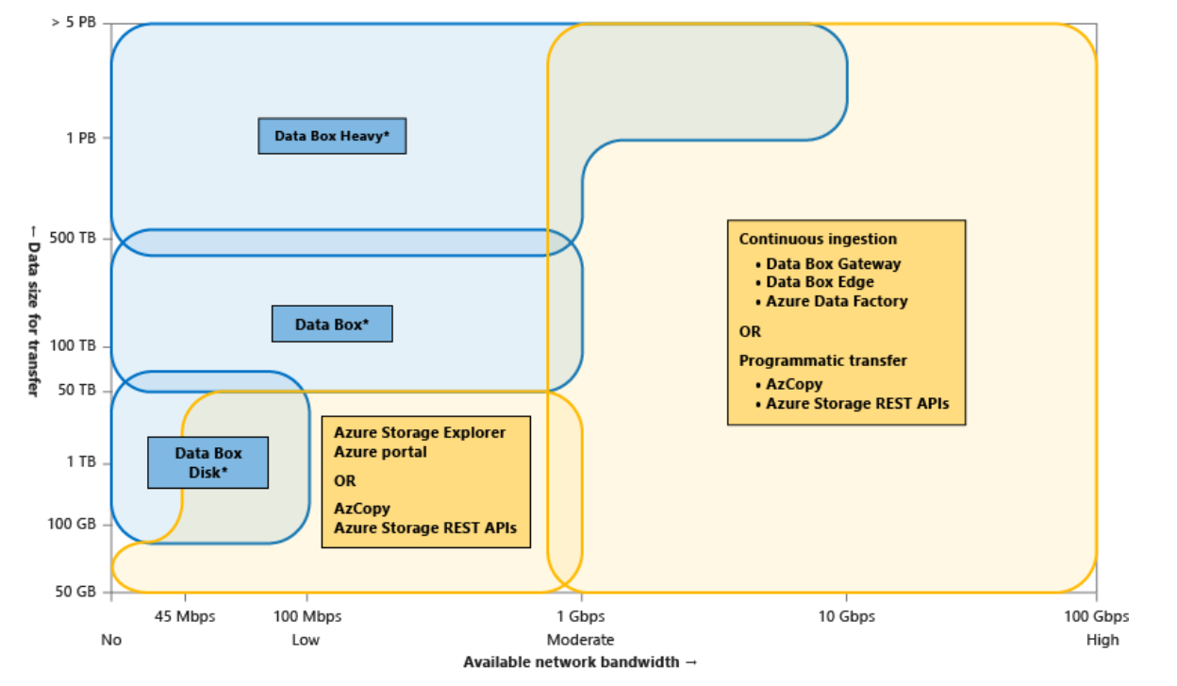
Choose Solution
Read Selecting a Data Transfer Solution

Slide 38
Import and Export Data to Azure
aka.ms/Azure/ImportExport
Azure Blob to disk drives
Ship drives to Azure
bitlockered
Or from blobs to on-premises disks
Use Cases
Data migration to the cloud
Content distribution
Backup
Data recovery
WAImportExport tool – cmd
V1 - use for blob storage
V2 – use for into Azure Files
WAImportExport
Repair an Export Job
/r
/d
/sn
/sk
/CopylogFile:C:\WAImportExport\DriverID.log

Slide 39
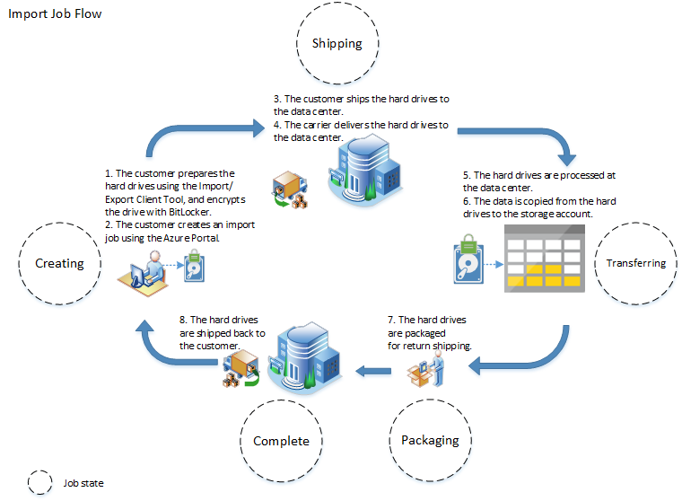
Import Job Flow
aka.ms/azureimportexport

Slide 40
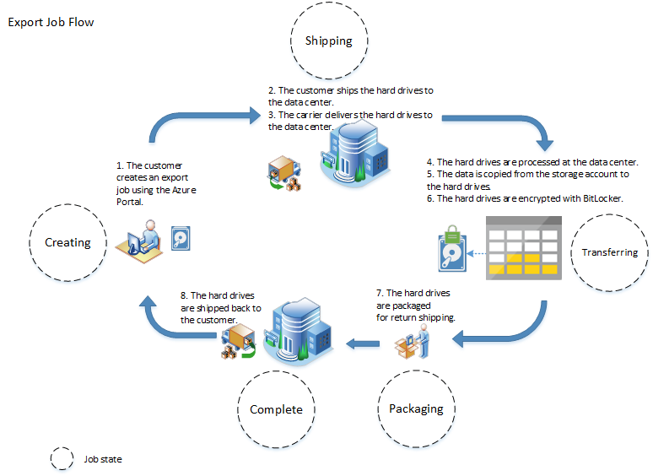
Export Job Flow
aka.ms/azureimportexport

Slide 41
Use Azure Data Box
docs.microsoft.com/azure/databox/
Order
Return
Upload
Receive
Copy Data
Prerequisites
Storage Account
EA, CSP or Azure Sponsorship
Subscription Owner or Contributor access
Via
SMB
NFS
REST
VHDs copied as page blobs, uploaded as managed disks
Uploaded to
Blobs in Storage Account
Managed Disks’ RG

Slide 42
Troubleshoot Azure File Sync
Error messages
Agent installation fails on Active Directory Domain Controller
When I register a server, I see numerous "web site not trusted" responses. – Why?
Cloud endpoint creation fails, with this error: "AuthorizationFailed“
Server endpoint creation fails, with this error: "MgmtServerJobFailed" (Error code: -2134375898)
Server endpoint deletion fails, with this error: "MgmtServerJobExpired“
Unable to open server endpoint properties page or update cloud tiering policy
Troubleshoot Azure File Sync

Slide 43
Deploy & Manage Azure Compute Resources 25-30%
Configure VMs for high availability and scalability
Automate deployment and configuration of VMs
Create and configure VMs
Create and configure containers
Create and configure Web Apps

Slide 44
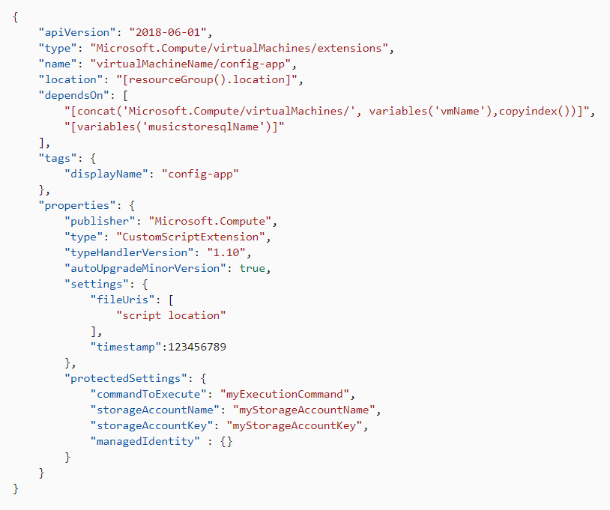
Using Custom Script Extensions
Know the Tips and Tricks!
Extension Schema
Property Values
commandToExecute
See the tutorial
https://docs.microsoft.com/en-us/azure/virtual-machines/extensions/custom-script-windows

Slide 45
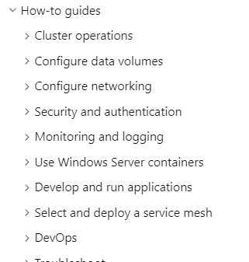
Create and Configure Azure Kubernetes Service
The Basics
Kubernetes RBAC
Roles
Also know about
Kubenet
Azure CNI
And compare the two!
Storage Concepts
Scale
JUST DO IT!
https://docs.microsoft.com/en-us/azure/aks/intro-kubernetes or download the docs as a PDF!

Slide 46
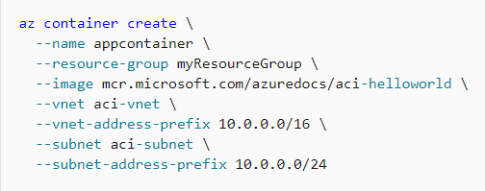
Create and Configure Azure Container Instances
Deploy into a Virtual Network
Manage Running Containers
Liveness probe
Readiness probes
Start & Stop
Update
https://docs.microsoft.com/en-us/azure/container-instances/container-instances-overview or
download the docs!

Slide 47
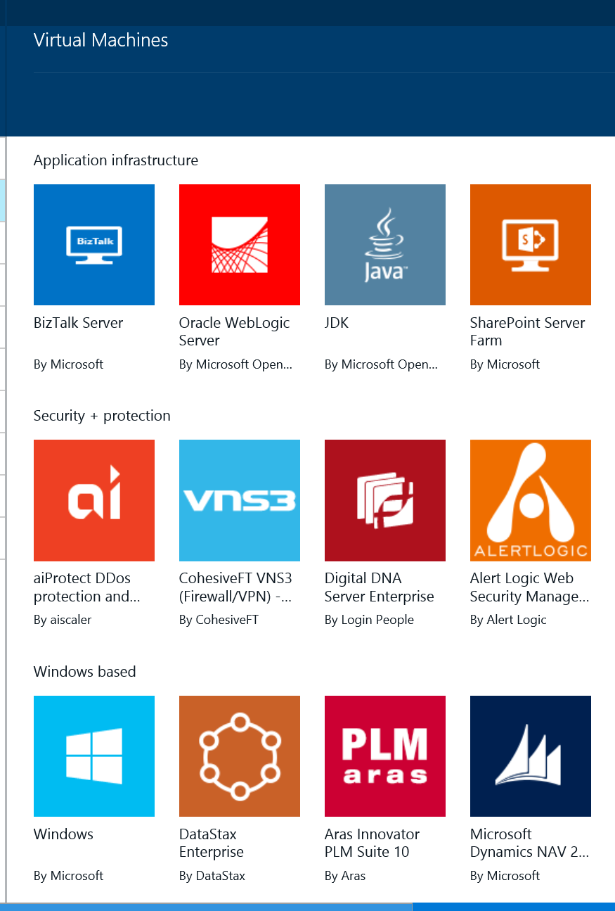
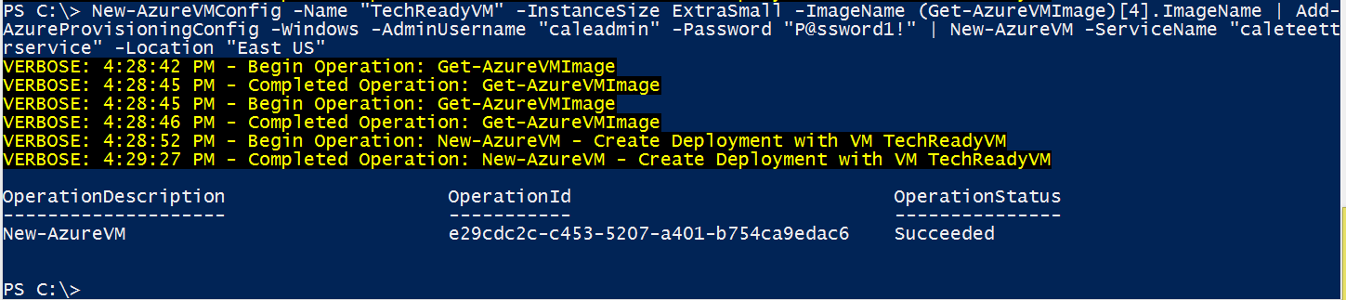
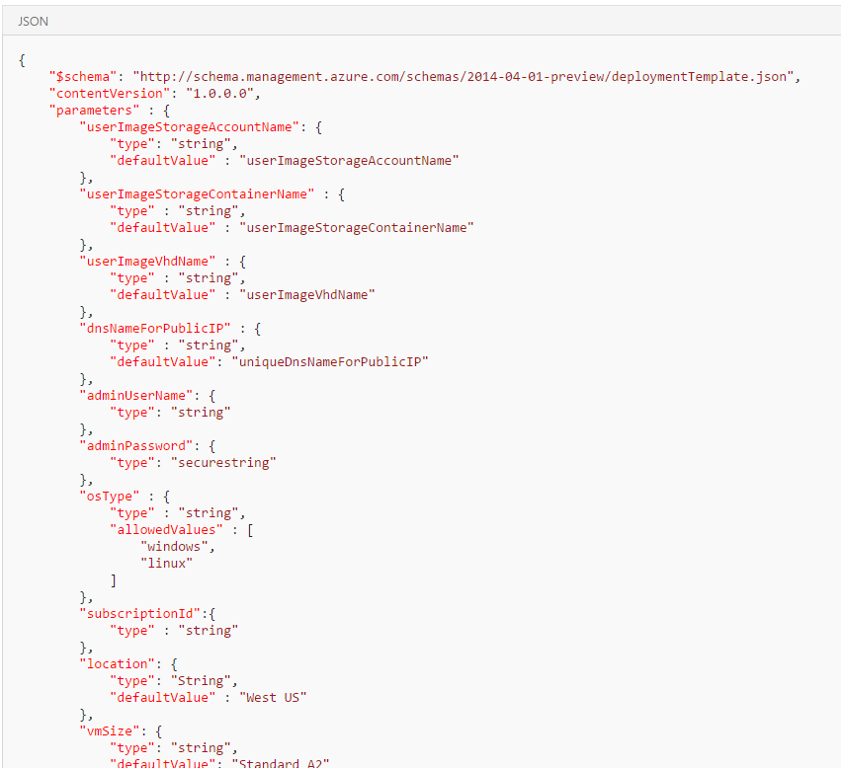
Automate Deployment of VMs
Deployment options
Marketplace
PowerShell
Azure CLI
ARM Template
Portal
Code (C#/Java/Python)
Different ways to create a VM

Slide 48
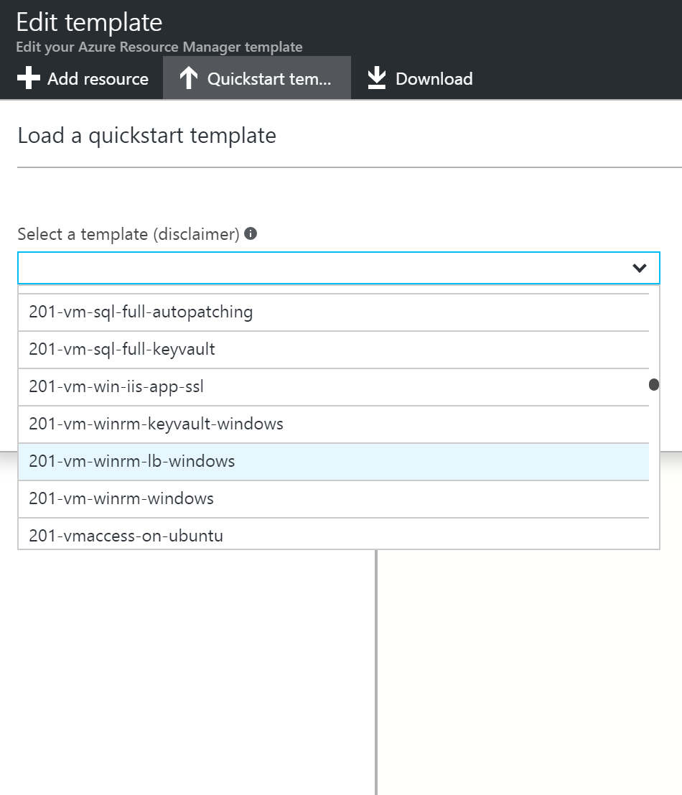
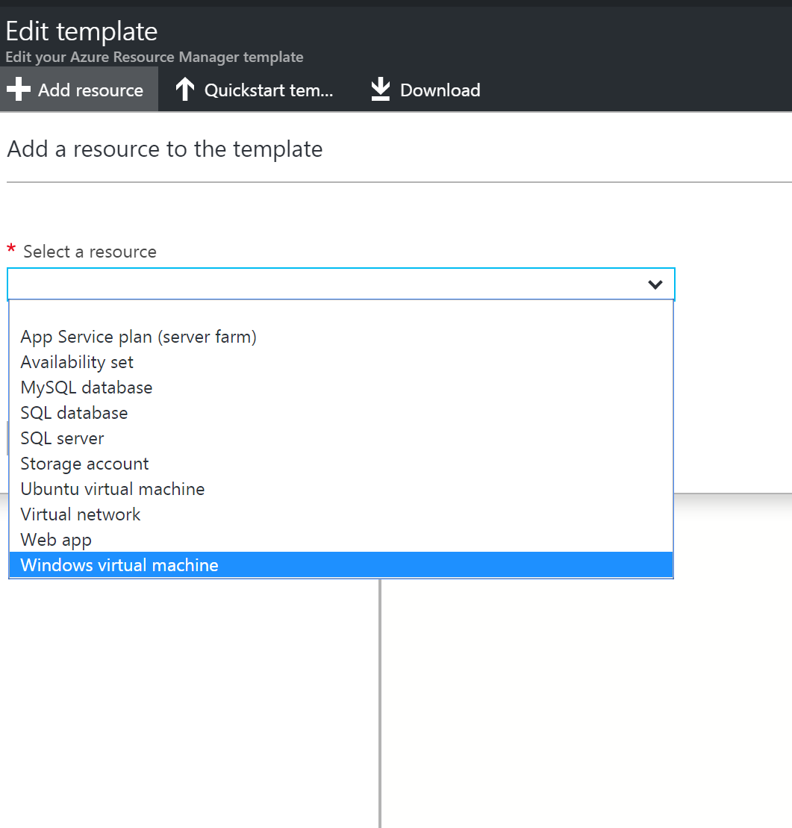
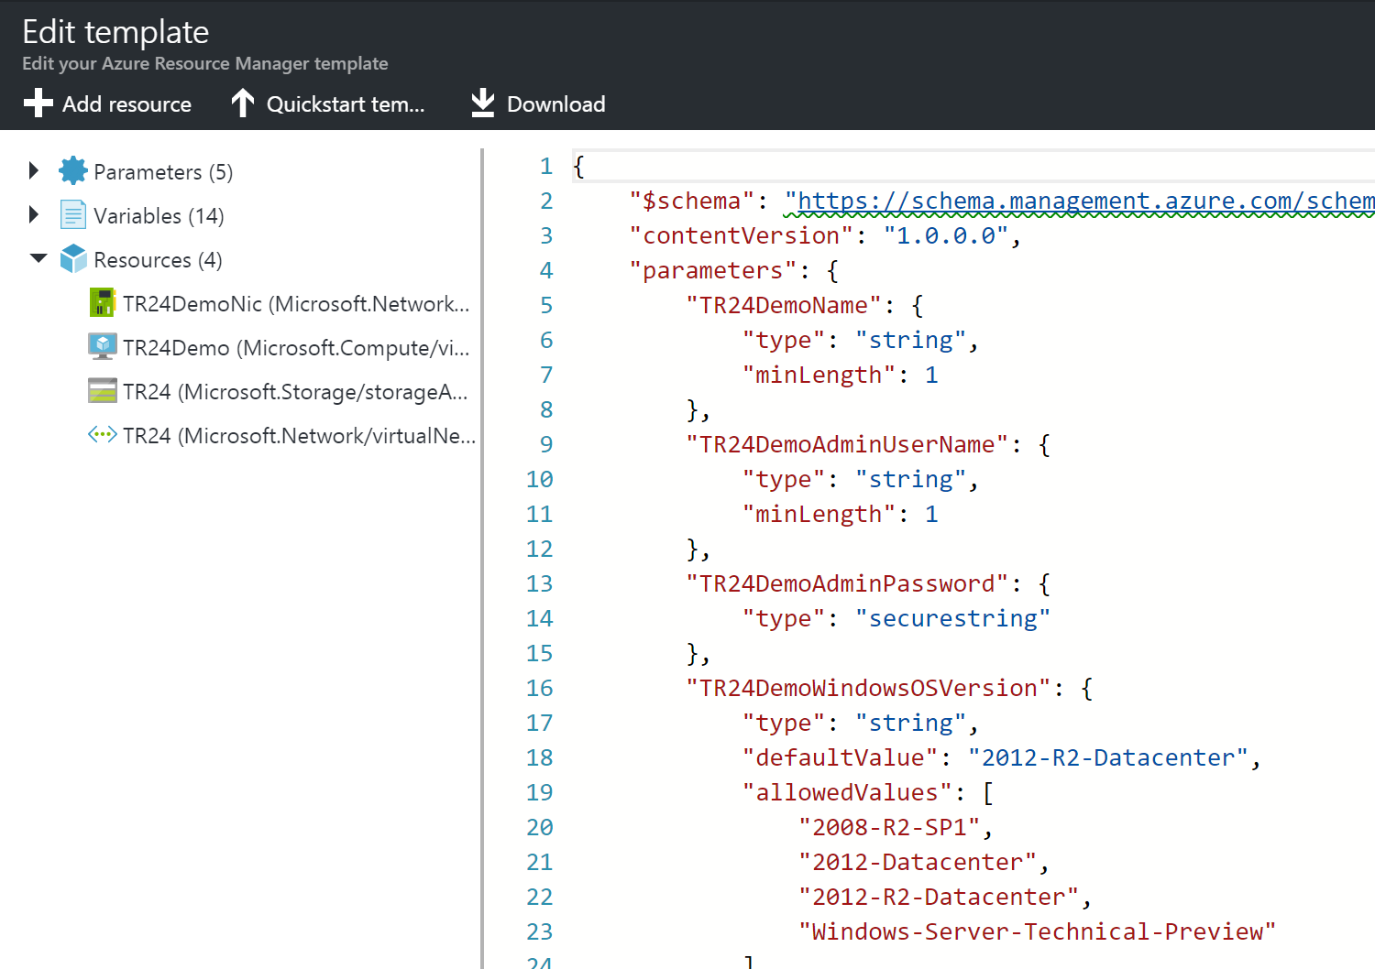




Automate Deployment of VMs ARM Templates
ARM Template Walkthrough

Slide 49


Manage Azure VM | redeploy VM
Methods
Azure Portal
PowerShell
Azure CLI 1.0/2.0
az vm redeploy --resource-group myResourceGroup --name myVM
azure vm redeploy --resource-group myResourceGroup --vm-name myVM

Slide 50

Deploy and Configure Scale Sets
Deploy
Visual Studio
Availability Zones
Placement Groups
Zone Balancing
Autoscale
Applications, Extensions, Data Disks, Encrypt disks
Configure
Modify Scale Set
Know Restrictions
When Deallocation required
See Scenarios
See Checklist for using Large Scale Sets!
Read VMSS w/ Availability Zones
Click the link

Slide 51

Backup Restore Encrypted VM
Prerequisites
If not from marketplace, then need to install VM Agent
Only explicitly allow outbound access if ExtensionSnapshotFailedNoNetwork error
Limitations
Must be in same subscription and region
Only standalone keys supported, not cert backed
Be in same region/subscription as Recovery Vault
Must recover entire VM for files/folders
Replace existing VM option only available for non-encrypted VMs

Slide 52
Deploy & Manage Virtual Networks 30-35%
aka.ms/VNetFAQ
Implement and manage virtual networking
Configure name resolution
Secure Access to Virtual Networks
Configure Load Balancing
Monitor and troubleshoot virtual networking
Integrate on premises network with Azure Virtual Network

Slide 53

Deploy and Configure Azure Bastion Service
Deploy
Do the Tutorial!
Read the FAQ!
Configure
NSG Access
Resource Logs
Monitor / Manage

Slide 54

Evaluate Effective Security Rules
Know how traffic is evaluated
Inbound / Outbound
Intra Subnet traffic
Use Network Watcher
IP Flow Verify
Quickstart to try it!
https://docs.microsoft.com/en-us/azure/virtual-network/network-security-group-how-it-works
https://docs.microsoft.com/en-us/azure/network-watcher/network-watcher-security-group-view-overview

Slide 55

Configure Express Route
Create a Circuit
Create and Modify Peering
Virtual Network Gateway
Connect Vnet to Circuit
Route Filters

Slide 56

Troubleshoot External Networking
Network Adapter
Network Security Group Settings
Connectivity Check
IP Flow Verify
Download the Azure Networking PDF!

Slide 57

Configure Application Gateway
Front End IP Address
Listeners
Request Routing Rules
HTTP Settings
Back End Pool
Health Probes
https://docs.microsoft.com/en-us/azure/application-gateway/configuration-overview

Slide 58

Configure Azure Virtual WAN
Site to Site
Custom IPSec Policy
User VPN
ExpressRoute
Encryption

Slide 59






The Big Picture | Segmentation & Isolation
Shared Services
PaaS Spoke 1
DDOS Protection
DDOS Protection
PIP
PIP
AppService subnet
NSG
Gateway subnet
WAF: HTTP/s ingress
Egress
Ingress (non-http/s) Spoke-Spoke
Spoke-On-Prem
Azure Key Vault
AD DS
Web server
Client
ExpressRoute
NSG
App Service
Firewall
ER Gateway
Application Gateway
Azure firewall
SQLDB
Spoke1 VNet
DNS
Client
On-prem system
DevOps
On-premises
Iaas Spoke2
Shared services subnet
N-tier subnet
Cloud native Security Services DDoS Protection for Public IPs
App GW WAF—Web Application Protection Azure Firewall—Full egress and ingress (non-http/s) controls
NSG—Internal VNET segmentation
Service Endpoints—Secure access to PaaS
NSG
NSG
SysOps
Bastion host
ADDS1
ADDS2
SQL1
Vnet Service Endpoint
Azure Key Vault
Hub virtual network
Web servers
Web API
SQL2
Vnet Service Endpoint
Cloud witness
SecOps
Spoke2 VNet
NetOps
Azure Management
Security Center
Azure Active Directory
Azure Key Vault
DevOps

Slide 60


Create Connectivity Between Virtual Networks Create and configure VNET peering
Benefits
Connect 2 VNets in same region
Routed through Azure Backbone
Requirements
Same Region & Across Regions
Read-Write to VNet
Non-overlapping IP Addresses
No Transitivity
Across Subscriptions possible with common tenant
Capabilities
Open or Close NSGs
Internal DNS only within VNet, no Azure DNS across
Service Chaining | Next Hop with UDR or Hub-Spoke
See Constraints!!!
aka.ms/Azure/Peering Just Do It!

Slide 61

Load Balancing
aka.ms/LoadBalancing
Basic
Visual Studio
Availability Zones
Placement Groups
Standard
Modify Scale Set
Know Restrictions
Steps
Create LB
Backend Pool
Health Probe
LB Rule

Slide 62
Name Resolution in VNets
Azure Provided
HA, resolve names between VMs in VNets
Cannot modify DNS Suffix, but can name hostname
Azure DNS IP is 168.63.129.16 – static, will not change
No WINS or NetBIOS
Use your own DNS
Use Windows Server Active Directory Domains
Resolve DNS Names between virtual networks
Can forward DNS queries to the recursive resolvers in Azure
Disable IPv6 for best performance with Azure VMs as DNS servers

Slide 63
DNS Records and Record Sets
Record Names
Uses relative names NOT fqdn
@ represents Apex (root) records
Record Types
Name and Type
A, AAAA, CAA, CNAME, MX, NS, PTR, SOA, SRV, and TXT
Record Sets
Azure DNS manages all DNS records using record sets
When more than one than one record with same ‘Name’ and Type’
Most record sets contain a single record
Reference article

Slide 64
DNS Records | Custom Domain | Web App
3 Records required
A -> contoso.com
TXT for verification
WWW to point to A
New-AzDnsRecordSet -Name "@" -RecordType "A" -ZoneName "contoso.com" ` -ResourceGroupName "MyAzureResourceGroup" -Ttl 600 ` -DnsRecords (New-AzDnsRecordConfig -IPv4Address "<your web app IP address>")
New-AzDnsRecordSet -ZoneName contoso.com -ResourceGroupName MyAzureResourceGroup ` -Name "@" -RecordType "txt" -Ttl 600 ` -DnsRecords (New-AzDnsRecordConfig -Value "contoso.azurewebsites.net")
New-AzDnsRecordSet -ZoneName contoso.com -ResourceGroupName "MyAzureResourceGroup" ` -Name "www" -RecordType "CNAME" -Ttl 600 ` -DnsRecords (New-AzDnsRecordConfig -cname "contoso.azurewebsites.net")

Slide 65

Delegation of DNS zones with Azure DNS
https://docs.microsoft.com/en-us/azure/dns/dns-domain-delegation

Slide 66
Azure Private DNS
No need for custom DNS solutions
Hostname resolution between virtual networks
Split-horizon DNS support
Within, Between VNets
Reverse DNS lookup is supported within the virtual-network scope
Can use CLI to import from provider, Win DNS or BIND
Read Private DNS FAQ
aka.ms/Azure/PrivateDNS

Slide 67

Host your Domain in Azure DNS
Create a DNS Zone
Enter your domain name e.g contoso.com
Retrieve Azure DNS Name Servers
Go to your registrar edit your NS records with Azure’s
Verify the registration with NSLOOKUP
https://docs.microsoft.com/en-us/azure/dns/dns-delegate-domain-azure-dns

Slide 68
Compare Network Tools
Network Watcher
designed to monitor and repair the network health of IaaS only
->connection monitor VM to Endpoint
i.e. point top point checking!
Part of Network Watcher
IP Flow Verify
Looks at the Rules for NSGs applied to NIC
Confirms is rule in NSG is blocking ingress or egress traffic to/from VM
NSG Flow Logs
IP Traffic Ingress and Ingress across NSG -> JSON
Configured on a per NSG
Stored in a Storage account – so SIEM can read!

Slide 69

Compare Network Tools
Network Performance Monitor (NPM) – 3 things…
Performance Monitor
Connectivity across clouds and on-prem
Service Connectivity Monitor
Test HTTP, HTTPS, TCP and ICMP in Real Time
Monitor to O365, Dynamics and PaaS
Network Topology Map
Express Route Monitor
Between Azure and Office over ER
Autodetection of Circuits, peering and topology
https://docs.microsoft.com/en-us/azure/azure-monitor/insights/network-performance-monitor

Slide 70

VNet Service Endpoints
Benefits
Removes Public IP
Traffic only to Vnet
Stays on backbone
No NAT or gateway devices needed
Simple click on Subnet
Can configure multiple services on subnet
Limitations
Not to on-premises
Azure SQL , applies only to Azure service traffic within a virtual network's region.
For Azure Storage, to support RA-GRS and GRS traffic, endpoints also extend to include paired regions where the virtual network is deployed

Slide 71
Monitor and back up Azure Resources 10-15%
Monitor resources by using Azure Monitor
Implement backup and recovery

Slide 72



Create Action Groups Create Action Groups

Slide 73

Configure Application Insights
Ways to get started
Runtime
Development time
Scan the FAQ
In Particular
“Have I enabled everything…”
https://docs.microsoft.com/en-us/azure/azure-monitor/app/app-insights-overview

Slide 74



Implement Azure Backup
Backup Policies
Policies
VM
Azure File Share
SQL Server in VM
aka.ms/Azure/Backup

Slide 75

Create and Configure Backup policy
Built-In Policy Definitions
Create a new backup policy
Datasource
Recovery Services Vault
Schedule
Retention
Considerations

Slide 76

Perform site-to-site recovery by using Azure Site Recovery
Setup Networking
URLs
Tags
NSG rules
NVAs
Network Service Endpoint
Recovery Point Options
Test Failover ex
https://docs.microsoft.com/en-us/azure/site-recovery/site-recovery-overview
https://docs.microsoft.com/en-us/azure/site-recovery/site-recovery-failover

Slide 77
Session takeaways
Know how to fish?
Know how to get this deck
Go register for the exam and take it!!!
Good Luck!

Slide 78

Certification Exam Rapid Training AZ-104 Azure Administrator
THANK YOU FOR ATTENDING!
Within 24 hours, the slides will be available for your use at
Aka.ms/AzureExamPrep -→>> in the “Files” tab
This recording will be later at aka.ms/CERT Closed Captioned in 6 languages! Japanese, Chinese, Korean, French, German and Portuguese
Additionally, you will find individual recordings of EACH module.
These will be 10-15 minutes each for easier consumption!

Slide 80

Older Slides for Self Review

Slide 81
Resource groups
Tightly coupled containers of multiple resources of similar or different types
Azure resources contained should have the same lifecycle
Every resource *must* exist in one and only one resource group
Resource groups can span regions
Nesting of resource groups not supported
Only Subscription Owners can create resource groups
RESOU
R
CE G
R
OUP

Slide 82
ARM Templates
Export-AzureRMResourceGroup
Captures Resource Group as a Template
Saves as a JSON File
Export-AzureRmResourceGroup -ResourceGroupName "TestGroup"
New-AzureRMResourceGroupDeployment
adds a deployment to an existing resource group
az group deployment create
[resourceGroup().location]
All resources in the template will use same location as the Resource Group will use

Slide 83





Create Azure File share
Fully managed file shares
SMB 3.0 support
Soft Delete on account
Can cache on File Sync
Replace or supplement File Shares
Lift/Shift Apps
Just share stuff!
aka.ms/azure/files Deploy Azure File Sync

Slide 84


Analyze Resource Utilization and Consumption Cost Management ( Cloudyn )
https://docs.microsoft.com/en-us/azure/cost-management/overview
Analyze usage
Monitor spend
Report on spend
Optimize
Reserved Instances
Sizing Recommendations

Slide 85

Create and Configure Storage Accounts
Configure Network Access
Enable Service Endpoints
Scope includes Paired Regions
Need Storage Account Contributor
Or Join Service to a Subnet permission on subnets
Can span subscriptions, not tenants
Configure Network rules
Can use CIDR notation
Or individual address
Make Exceptions
Trusted Microsoft Services
E.g. Azure Backup, DevTest labs, Event Grid/Hubs, Networking
aka.ms/Azure/Storage
MUST Read How To

Slide 86
Optimize CDN Delivery
Provider Options
Azure CDN Standard from Microsoft
General Web Delivery
Azure CDN Standard/Premium from Verizon
General Web Delivery
Dynamic Site Acceleration
Azure CDN Standard from Akamai
General web delivery
General media streaming
Video-on-demand media streaming
Large file download
Dynamic site acceleration
Read More

Slide 87
PowerShell Options to understand
Update-AzureRMStorageAccountNetworkRuleSet
Set-AzureRmStorageAccount
Add-AzureRmStorageAccountNetworkRule
Set-AzureRmVirtualNetworkSubnetConfig

Slide 88
Log Analytics Workspace
Central Resource monitoring solution
Has its own query language
Each Workspace –own configuration data
Can Collect Data from
Azure resources in your subscription
On-premises computers monitored by System Center Operations Manager
Device collections from System Center Configuration Manager
Diagnostics or log data from Azure storage

Slide 89













The Big Picture | Application Access Patterns
2
Your Virtual Network
Users
Internet
1
FrontEnd
Mid-tier
BackEnd
Access to Azure PaaS services
Access to/from Internet
- DDoS protection
- Web Application Firewall
- Azure Firewall
- Network Virtual Appliances
Service Endpoints
Backend Connectivity
ExpressRoute
VPN Gateways
3
Access private traffic
Network security groups (NSGs)
Application security groups (ASGs)
User-Defined routes (UDRs)

Slide 90


Implement and Manage Virtual Networking
Public IP
Separate Azure Object
Public Azure Service
VMs, ILBs, VPN, App GWs
Dynamic (default) or Static
DNS hostname resolution
Private IP
Allocated from subnet range
Internal resolution by Azure DNS
Subnet, part of VNet range
VM, ILBs, App GWs
Dynamic (default) or Static
aka.ms/Azure/Addresses

Slide 91

Configure Name Resolution
aka.ms/DNSFAQ
Create DNS Zone
Zone name must be unique within Resource Group
Can add Azure Tags for Billing or Grouping
Creating the zone makes SOA and NS records in Azure
Create DNS Record
Azure DNS supports all common records
Use Record Sets for more than one record of same name and type + wildcard!
SOA and CNAME are exceptions to Rule above
Delegate Domain to Azure DNS
Must know zone server names
Get-AzureRmDnsZone –Name contoso.net –ResourceGroupName MyResourceGroup
aka.ms/Azure/DNS

Slide 92








Virtual Networks
Your virtual private network in the cloud
10.1.0.0/16
Private isolated logical network
Supports Network ACLs and IP Management
User defined routing for network virtual appliances
Extends on-premises network to the cloud
Provides secure connectivity to Azure services
UDR
Internet
On-premises
Azure Services
https://docs.microsoft.com/en-us/azure/virtual-network/virtual-network-vnet-plan-design-arm

Slide 93

Network & Application Security Groups
Network Security Groups
Protects your workloads with distributed ACLs
Simplified configuration with augmented security rules
Enforced at every host, applied on multiple subnets
Application Security Groups
Micro-segmentation for dynamic workloads
Named monikers for groups of VMs
Removes management of IP addresses
Service Tags
Named monikers for Azure service IPs
Many Services tagged including AzureCloud
Logging and troubleshooting
NSG flow logs for traffic monitoring
Integrated with Network Watcher
JIT access policies with Azure Security Center
NSG
Network Security Group (NSG)
Action | Name | Source | Destination | Port
Allow | AllowInternetToWebServers | Internet | WebServers | 80,443(HTTP)
Allow | AllowWebToApp | WebServers | AppServers | 443 (HTTPS)
Allow | AllowAppToDb | AppServers | DatabaseServers | 1443 (MSSQL)
Deny | DenyAllInbound | Any | Any | Any
Internet
Web Servers
App Servers
Database Servers
Web1
App1
Db1
Web2
App2
Db2

Slide 94
Subnets
Segmenting the Virtual Network
Must have unique Address range within Vnet
Some Azure Services create their own subnets
Understand Default routing behavior
Can limit traffic out to Azure Services
Allow or Deny Traffic with NSGs
https://docs.microsoft.com/en-us/azure/virtual-network/virtual-networks-udr-overview

Slide 95




Monitor and Troubleshoot Networking Use Network Watcher
Create
Portal, PSH, CLI, RestAPI
Features to view/configure
Topology
Packet Capture
IP Flow Verify
Next Hop
Security Group view
NSG flow logging
Virtual Network Gateway troubleshooting

Slide 96

Integrate On-Premises Network with Azure Virtual Network Configure Express Route
Just watch a video
Create a circuit ☺
Send Service key to provider
Create / Modify peerings
Public or Private
Link Virtual Network to Circuit
Can also link to other subscriptions!
Deprovision/Delete circuit
aka.ms/Azure/ExpressRoute

Slide 97
Network Watcher | PowerShell
Create a New One
$networkWatcher = New-AzNetworkWatcher ` -Name "NetworkWatcher_eastus" ` -ResourceGroupName "NetworkWatcherRG" ` -Location "East US“
Retrieve Network Watcher
$networkWatcher = Get-AzNetworkWatcher ` -Name NetworkWatcher_eastus ` -ResourceGroupName NetworkWatcherRG
View Details of a Security Rule
Get-AzEffectiveNetworkSecurityGroup ` -NetworkInterfaceName myVm ` -ResourceGroupName myResourceGroup

Slide 98




VPN Gateway Redundancy
Options
Multiple On-premises devices
Active-Active VPN devices
Dual Redundancy
Azure-Azure VPN GW HA
Configure Active-Active
Need 2 Gateway IP configurations & 2 public IP addresses
Set the EnableActiveActiveFeature flag
The gateway SKUs
VpnGw1
VpnGw2
VpnGw3
or HighPerformance (legacy SKU).

Slide 99

Create and Configure a Network Security Group (NSG)
Apply at Subnet or NIC
Only 1 NSG per Azure Resource
Only TCP or UDP
Special Rules
Microsoft Owned IP Address of 168.63.129.16
Outbound Port 1688 reserved for KMS
aka.ms/Azure/NSG

Slide 100

IPv6
Features
Load-balanced IPv6 services for IPv6 clients on the Internet
Native IPv6 and IPv4 endpoints on VMs ("dual stacked")
Inbound and outbound-initiated native IPv6 connections
Supported protocols such as TCP, UDP, and HTTP(S) enable a full range of service architectures
Limitations
Can’t add IPv6 LB rules in portal
Can’t upgrade VMs to IPv6
Only assign to LB, not VM
No DNS reverse lookup

Slide 101
3 Supported methods VM Static IP
New AzureRMNetworkInterface -PrivateIPAddress
Azure Portal Set after VM Creation
az network nic create

Slide 102
Troubleshoot Load Balancing (LB)
Not responding to Health Probes
Backend Pool Unhealthy | PsPing or TCPing
Backend Pool not listening on probe port | netstat –an ?LISTENING
Firewall or NSG blocking port
VMs behind not responding to traffic on port
LB BackEnd Pool VM not listening
NSG blocking port
Accessing LB from same VM / NIC
Accessing LB frontend from participating LB backend pool
Read Troubleshoot Doc

Slide 103










Implement and Manage Hybrid Identities Install and configure Azure AD Connect
aka.ms/Azure/AD/Connect
Much more in here!!!!

Slide 104
Manage Azure Active Directory (AD) Enterprise State Roaming
Requires
Azure AD Premium
Windows 10
Azure AD Domain Join
Other Notables
3 regions: NA, EMEA, APAC
Not replicated across
Country/Region set on attribute
Cannot be changed after!
Retention
Retained until deleted or becomes “Stale”
aka.ms/Azure/Roaming

Slide 105






Manage Azure Active Directory (AD)
Conditional Access
Identity Protection
Multi-Factor Authentication
Providing conditional access control to APIs+ applications
With "What if" capabilities
Integrating behavior-based threat analytics via risk-based policies against suspicious logins and compromised credentials
USER ATTRIBUTES
User identity
Roles and group memberships
Authentication strength/context
Applications & APIS
in some clouds or elsewhere
Controls
Azure AD MFA
DEVICE
Registration state
Health state and policy compliancy
Platform type
Lost or stolen
Allow Access
Enforce multifactor authentication
LOCATION
IP range
Force password Reset
CONDITIONS
*****
APPLICATION
Application policy
Client type (native, web)
Block Access
Other
Risk profile
Terms of Use
Time
Limit access
10 To
par jour

Slide 106

Implement Multi-Factor Authentication (MFA)
License Requirements
Azure Multi-Factor Authentication
Azure Active Directory Premium
Enterprise Mobility + Security
Turn on two step verification
For all users …or
Conditional Access
Configure settings such as…
Block users
Fraud Alert
Caching
Trusted Ips, Verification methods….
Read them all! – how to
aka.ms/Azure/MFA

Slide 107

Implement and Manage Hybrid Identities
Cloud/ManageD IdentitY
SynchroniZED IdentitY
(WITH OR WITHOUT PASSWORD synchroniZation)
SynchroniZED IdentitY
(WITH PASS-TRHOUGH uthentication (PTA))
FEDERATED IdentitY
Azure AD Connect HeAlth
Azure AD Connect HeAlth
Azure AD Connect HeAlth
Your AZURE AD
TENANT
Your AZURE AD
TENANT
Your AZURE AD
TENANT
Your AZURE AD
TENANT
Cloud Identity
Synchronized Identity
Synchronized Identity
with PTA
Federated Identity
Local identity
Local identity
Local identity
Authentication
Azure AD COnnect
Azure AD COnnect
Azure AD COnnect
FEdEration
Authentication
Local Identity
Local Identity
Local Identity
No infrastructure ON-PREMISES
Your on-premises
DIRECTORY
Your on-premises
DIRECTORY
Your on-premises
IDP/
DIRECTORY
aka.ms/hybrid/sso
aka.ms/ptauth
aka.ms/hybrid/sso
aka.ms/SSOProviders

